Slide 1
Lexical Semantics
CS 162: Natural Language Processing
Nanyun (Violet) Peng
Course website: https://vnpeng.net/cs162_win24.html
syllabus,
announcements,
slides,
homeworks
1

Slide 2
How do we represent a word?
How do we “understand” a word?
How can we know the relation/distance/similarity between words computationally?
***Discussion***
2

Slide 3
Representing words as discrete symbols
Naïve way: represent words as atomic symbols: student, talk, university (BoW)
Represent word as a “one-hot” vector [ 0 0 0 1 0 … 0 ]
How large is (what’s the dimension of) this vector?
Vector dimension = number of words in vocabulary
PTB data: ~50k,
Google 1T data: 13M
egg student talk university happy buy
3

Slide 4
Issues?
Dimensionality is large; vector is sparse
No similarity
V_{happy} = [0 0 0 1 0 ... 0 ]
V_{sad} = [0 0 1 0 0 ... 0 ]
V_{milk} = [1 0 0 0 0 ... 0 ]
V_{happy} • V_{sad} = V_{happy} • V_{milk} = 0
Cannot represent new words
4

Slide 5
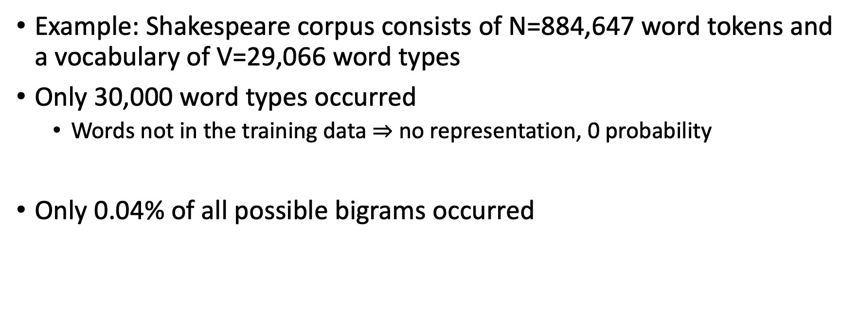
How about unseen words/phrases
Example: Shakespeare corpus consists of N=884,647 word tokens and a vocabulary of V=29,066 word types
Only 30,000 word types occurred
Words not in the training data $⇒$ no representation, 0 probability
Only 0.04% of all possible bigrams occurred
5

Slide 6
What is Lexical Semantics
Word meanings that can help decide:
Word Similarity
Distributional (Vector) Models of Meaning
Word Relations
Word Sense Disambiguation
Semantic Roles
6

Slide 7
Intuition of Semantic Similarity
Semantically Close
bank-money
apple-fruit
tree-forest
bank-river
pen-paper
run-walk
mistake-error
car-wheel
Semantically Distant
doctor-mall
painting-January
math-river
apple-penguin
nurse-fruit
pen-river
clown-rocket
car-algebra
7

Slide 8
Why Are Two Words Related?
Meaning
Two concepts are close in terms of meaning (want-desire)
World knowledge
Two concepts have similar properties, often occur together, or occur in similar contexts (pencil-pen, pen-ink, dog-cat)
Psychology
We often think of the two concepts together (voting-home address, red-luck[in some culture])
8
Notes:
Can you give more examples for each case?

Slide 9
Validity of Semantic Similarity
Is semantic distance a valid linguistic phenomenon? ➔ how would you approach this problem?
Experiment (Rubenstein and Goodenough, 1965)
Compiled a list of word pairs
Subjects asked to judge semantic distance (from 0 to 4) for each pair
Results
Rank correlation between subjects is ~ 0.9
People are consistent!
What can we use semantic similarity for? (discussion)
9

Slide 10
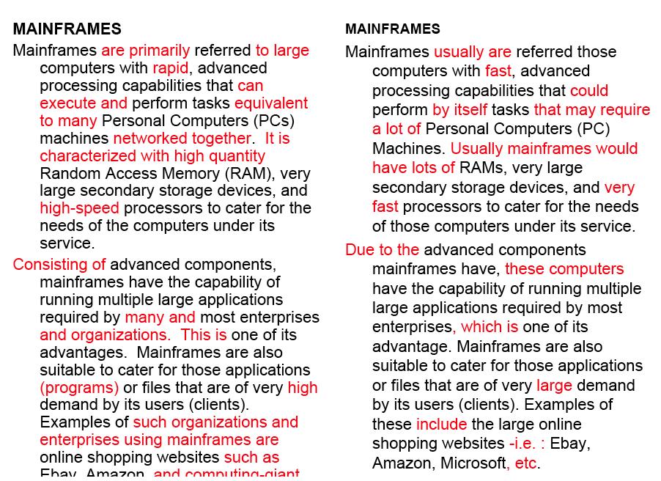
Word similarity for plagiarism detection

Slide 11
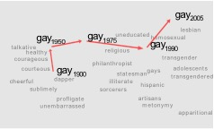
Word similarity for historical linguistics: semantic change over time
Sagi, Kaufmann, Clark 2013
Kulkarni, Al-Rfou, Perozzi, Skiena 2015
how general are terms over time?
11

Slide 12
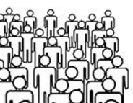
Word similarity reflects gender stereotype
327 gender neutral occupations. Project on to she—he direction.
homemaker
receptionist
boss
maestro
she
he
nurse
philosopher
Crowdworkers rate each occup. for gender stereotype
Highly Correlated (Spearman ρ = 0.51)
12
Notes:
Besides, if we consider 327 gender neutral occupations based on US labor statistics and project them into gender direction defined by gender pronouns he and she. This gives a nice, immediate way to visualize the data, and it already suggests that there is quite a bit of gender stereotype. As you can see... To make this more systematic, we have an Amazon Mechanical Turk pipeline, where we ask 10 crowdworkers to rate each occupation as to how much it exhibits male or female stereotype.

Slide 13
Two classes of similarity algorithms
Thesaurus-based algorithms
Are words “nearby” in a thesaurus hierarchy?
Do words have similar glosses (definitions)?
Distributional algorithms
Do words behave similarly in real-world usage?
13

Slide 14
WordNet: Online thesaurus

Slide 15
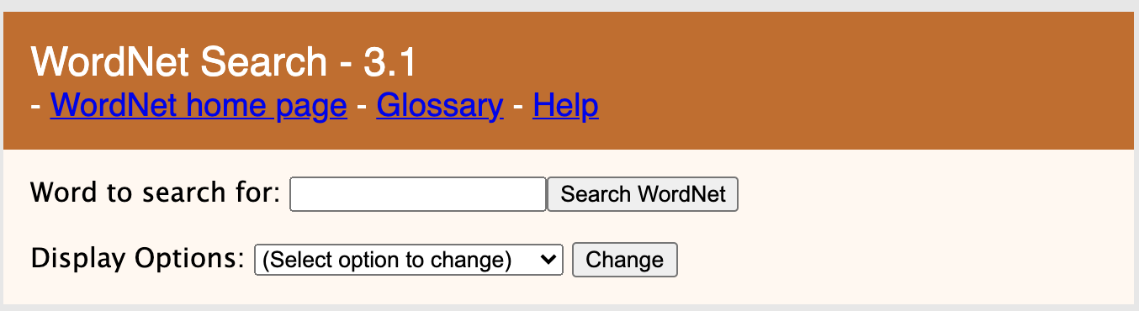
WordNet 3.1
A hierarchically organized lexical database of English
On-line thesaurus
globalwordnet.org: wordnets in 50+ languages
quality/coverage/availability varies
Category | Unique Strings
Noun | 117,798
Verb | 11,529
Adjective | 22,479
Adverb | 4,481
15

Slide 16
Terminology: lemma and wordform
A lemma or citation form
Representation of all forms with the same stem, part of speech, rough semantics
A wordform
The inflected word as it appears in text
Wordform | Lemma
banks | bank
sung, singing | sing
broke, broken | break
16
Notes:
Plural, past tense, past participle

Slide 17
Lemmas have senses
One lemma “bank” can have many meanings:
…a bank can hold the investments in a custodial account…
“…as agriculture burgeons on the east bank the river will shrink even more”
Sense (or word sense)
A discrete representation
of an aspect of a word’s meaning.
The lemma bank here has two senses
Sense 1:
1
Sense 2:
2
17

Slide 18
Homonymy: multi-sense as an artifact
Homonyms: words that share a form (spelling or pronounciation) but have unrelated, distinct meanings:
bank₁: financial institution, bank₂: sloping land
bat₁: club for hitting a ball, bat₂: nocturnal flying mammal
Homographs (bank/bank, bat/bat)
Homophones:
Write and right
Piece and peace
18

Slide 19
Homonymy causes problems for NLP applications
Information retrieval
“bat care”
Machine Translation
bat: murciélago (animal) or bate (for baseball)
Text-to-Speech
bass (stringed instrument) vs. bass (fish)
19
Notes:
English--Spanish

Slide 20
Polysemy: related multi-sense
1. The bank was constructed in 1875 out of local red brick.
2. I withdrew the money from the bank
Are those the same sense?
Sense 2: “A financial institution”
Sense 1: “The building belonging to a financial institution”
A polysemous word has related meanings
Most non-rare words have multiple meanings
20

Slide 21
How do we know when a word has more than one sense?
The “zeugma” test: Two senses of serve?
Which flights serve breakfast?
Does Lufthansa serve Philadelphia?
?Does Lufthansa serve breakfast and Philadelphia?
Since this conjunction sounds weird,
we say that these are two different senses of “serve”
21

Slide 22
Synonyms
Words (different forms) that have the same meaning in some or all contexts.
filbert / hazelnut
couch / sofa
big / large
automobile / car
vomit / throw up
Water / H₂0
22

Slide 23
Synonymy is a relation between senses rather than words
Consider the words big and large
Are they synonyms?
How big is that plane?
Would I be flying on a large or small plane?
How about here:
Miss Nelson became a kind of big sister to Benjamin.
?Miss Nelson became a kind of large sister to Benjamin.
Why?
big has a sense that means being older, or grown up
large lacks this sense
23

Slide 24
Antonyms
Senses that are opposites with respect to one feature of meaning
Otherwise, they are very similar!
dark/light short/long fast/slow rise/fall
hot/cold up/down in/out
More formally: antonyms can
define a binary opposition
or be at opposite ends of a scale
long/short, fast/slow
Be reversives:
rise/fall, up/down
24

Slide 25
Hyponymy and Hypernymy
One sense is a hyponym of another if the first sense is more specific, denoting a subclass of the other
car is a hyponym of vehicle
mango is a hyponym of fruit
Conversely hypernym/superordinate (“hyper is super”)
vehicle is a hypernym of car
fruit is a hypernym of mango
Superordinate/hyper | vehicle | fruit | furniture
Subordinate/hyponym | car | mango | chair
25

Slide 26
Hyponymy more formally
Entailment:
A sense A is a hyponym of sense B if being an A entails being a B
Hyponymy is usually transitive
(A hypo B and B hypo C entails A hypo C)
Another name: the IS-A hierarchy
A IS-A B (or A ISA B)
B subsumes A
26

Slide 27
Meronymy
The part-whole relation
A leg is part of a chair; a wheel is part of a car.
Wheel is a meronym of car, and car is a holonym of wheel.
27

Slide 28
How is “sense” defined in WordNet?
The synset (synonym set), the set of near-synonyms, instantiates a sense or concept, with a gloss
Example: chump as a noun with the gloss:
“a person who is gullible and easy to take advantage of”
This sense of “chump” is shared by 9 words:
chump¹, fool², gull¹, mark⁹, patsy¹, fall guy¹, sucker¹, soft touch¹, mug²
Each of these senses have this same gloss
(Not every sense; sense 2 of gull is the aquatic bird)
28

Slide 29
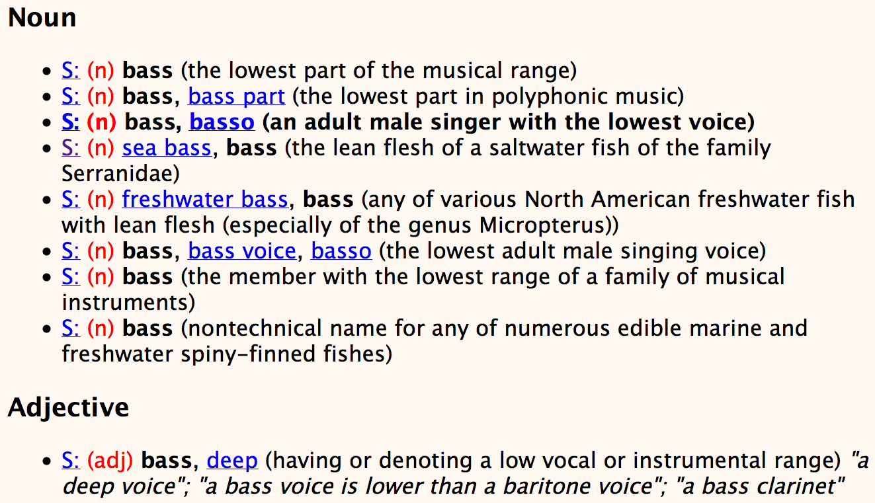
Senses of “bass” in Wordnet

Slide 30
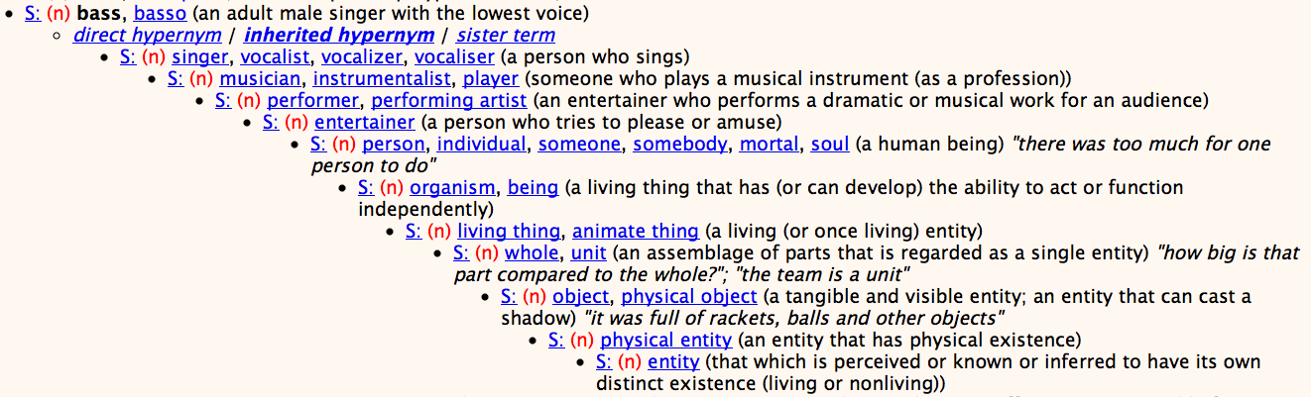
WordNet Hypernym Hierarchy for “bass”
30

Slide 31
Word Similarity
Synonymy: a binary relation
Two words are either synonymous or not
Similarity (or distance): a looser metric
Two words are more similar if they share more features of meaning
Similarity is properly a relation between senses
It’s not the word “bank” that is similar to the word “slope”
Rather, Bank¹ is similar to fund³
Bank² is similar to slope⁵
But we can compute similarity over both words and senses
31

Slide 32
Thesaurus-based similarity algorithms
Thesaurus-based algorithms
Are words “nearby” in hypernym hierarchy?
Do words have similar glosses (definitions)?
Distributional algorithms
Do words have similar distributional contexts?
32

Slide 33
Path based similarity
Two concepts (senses/synsets) are similar if they are near each other in the thesaurus hierarchy
=have a short path between them
concepts have path 1 to themselves
33

Slide 34
Refinements to path-based similarity
pathlen(c₁,c₂) = 1 + number of edges in the shortest path in the hypernym graph between sense nodes c₁ and c₂
simpath(c₁,c₂) =
ranges from 0 to 1
wordsim(w₁,w₂) = max simpath(c₁,c₂)
c₁∈senses(w₁),
c₂∈senses(w₂)
34

Slide 35
Example: path-based similarity simpath(c₁,c₂) = 1/pathlen(c₁,c₂)
simpath(nickel,coin) = 1/2 = .5
simpath(fund,budget) = 1/2 = .5
simpath(nickel,currency) = 1/4 = .25
simpath(nickel,money) = 1/6 = .17
simpath(nickel,standard) = 1/6 = .17
35
Notes:
Interaction ask students to compute

Slide 36
Thesaurus Methods: Limitations
Measure is only as good as the resource
Missing nuances (e.g., good vs. proficient)
Missing new concepts/new meanings of words
Limited in scope
Assumes IS-A relations
Works mostly for nouns
Role of context not accounted for
Not easily domain-adaptable
Resources not available in many languages
36

Slide 37
Next...
Distributional Semantics
Intuition
Sparse representation
Term-document matrix
Term-context (term-term) matrix
PMI
Cosine similarity
LSA
Word2Vec

